Slide 1


Alpha Phi Omega
Chi Chapter at UCLA
Alpha Mu / Kay Krenek Term, Meeting 4
November 5, 2014
www.apo-x.org

Slide 2
Agenda
1. Officer Updates and Announcements
2. Chapter Business
3. Advisor Special Election
4. SAA Special Election Nomination
4. Last Announcements

Slide 3
President
Raymond Mai
president@apo-x.org
Executive Committee
excomm@apo-x.org

Slide 4
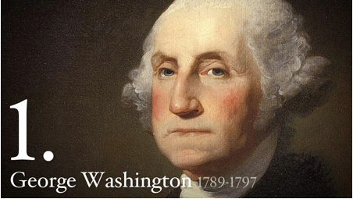

GO AMERICA!!!!
TRIVIA TIME:
US First President?
ONLY THE GREATEST: GEORGE WASHINGTON
Law of the Land?
THAT’S RIGHT: US CONSTITUTION
Greatest Country on Earth?
YOU’RE CORRECT: UNITED STATES OF AMERICA

Slide 5


APO Sign = Quiet Down, Bruh
ACTIVES PLEDGES
When we get rowdy,
I’ll be using this sign,
then Excomm will follow,
then you all follow!
Better than banging
the gavel, right?

Slide 6
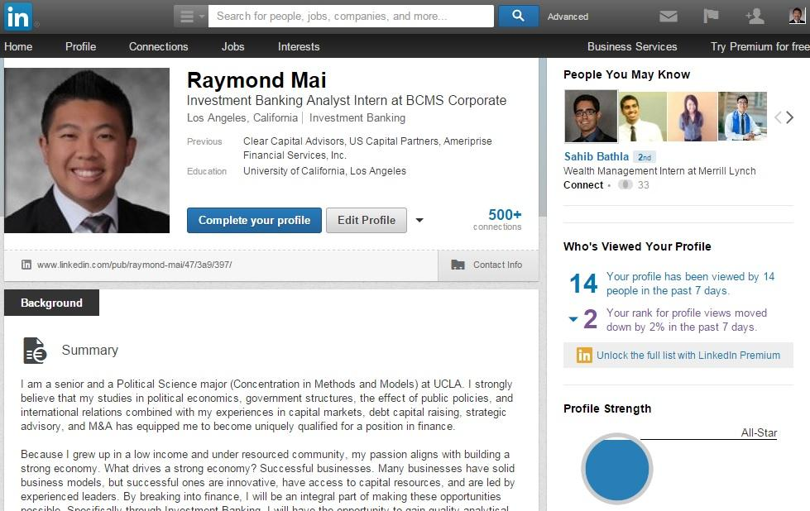
Career Development
MY LEADERSHIP WORKSHOP:
THURSDAY
7:00pm
ROLFE 3105
30 person cap
One person is interested in holding their own workshop
Let me know if you want to host one!

Slide 7

Mental Health Awareness
New active committee
ONE (1) POSITIONS OPEN
If you are interested in helping me increase mental health awareness for the chapter, contact me!

Slide 8
Meeting Room Next Week
MEETING ROOM FOR THE NEXT TWO WEEKS:
MS4000A
**Math and Science Building for you North Campus majors.

Slide 9

Excomm Meetings
Need leadership credit?
Come to Excomm Meetings!
Sundays at 8pm
Usually at Jeremy’s - Evergreen 415
No Excomm meeting this week because of revelations
Contact me if you are coming!
619-248-1113
President@APO-x.org

Slide 10

TRASH
Thank you for picking up your trash last meeting
Let’s keep it up!
A CLEAN ENVIRONMENT IS A HAPPY ENVIRONMENT

Slide 11
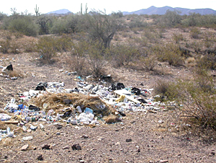
Campout Announcements
As a reminder from campout:
Make sure to NOT drive back from campout without your full car
Also, please pick up your trash. Pledges, PAC, and PPs should not be the only ones picking up trash in the rain

Slide 12
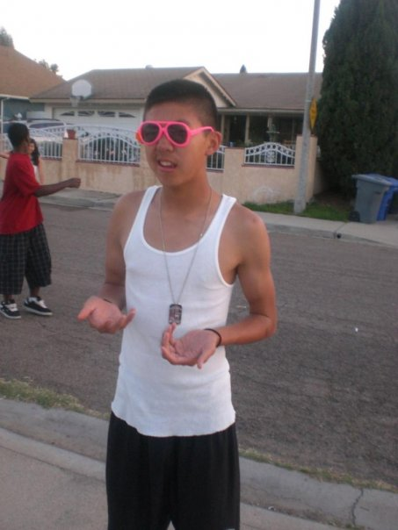

HAVE A SWAG WEEK, PLS.
Good luck with midterms!
Have fun at revelations too!

Slide 13
Administrative VPs
Kevin Quizon & Nicola Yip
admin@apo-x.org

Slide 14
Things you might not have known about the website....

Slide 15
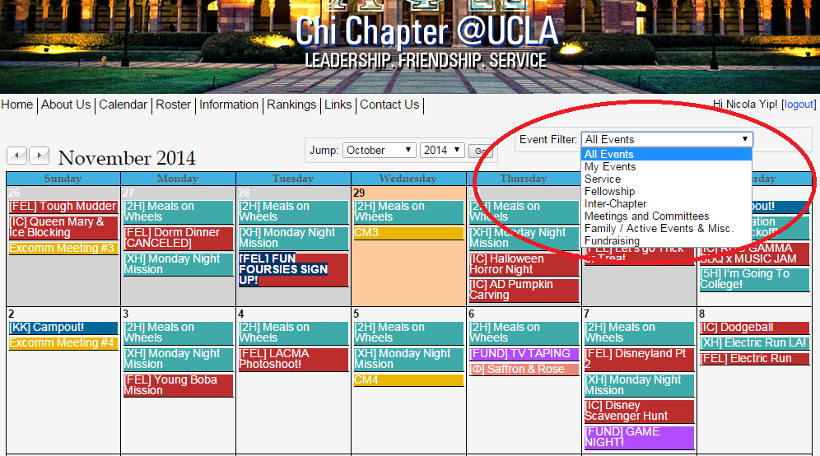

Slide 16
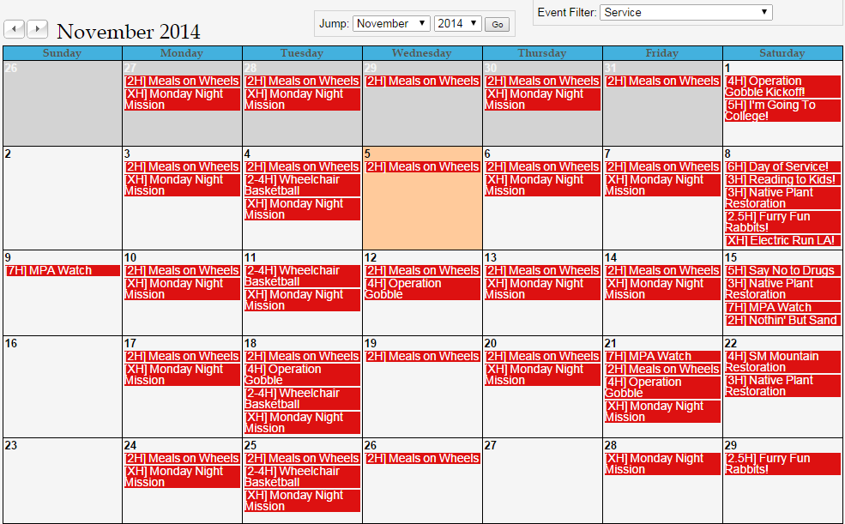

Slide 17
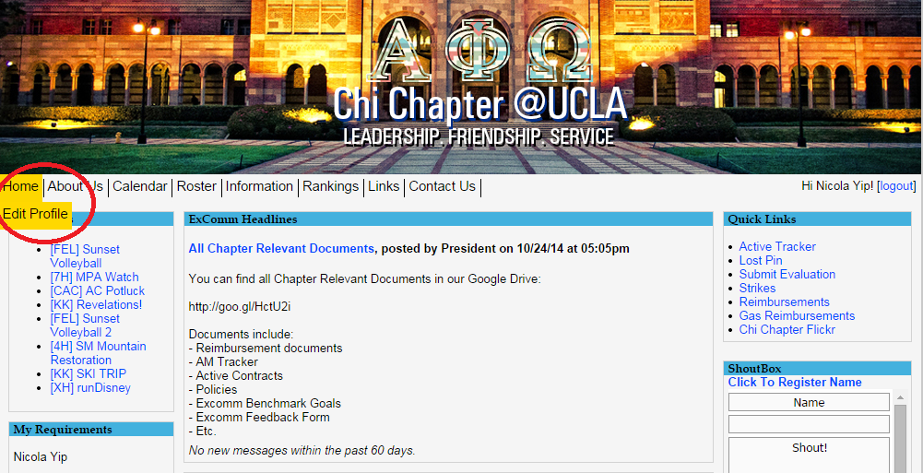

Slide 18
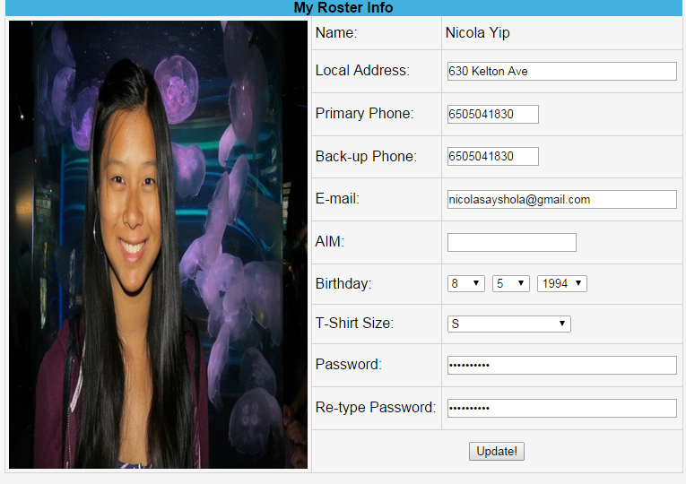

Slide 19
ALumni Mentorship Apps!
Applications are now available! Check your emails!

Slide 20
MEMBERSHIP.
Jeremy Gozzip & Andrew Suh
membership@apo-x.org

Slide 21
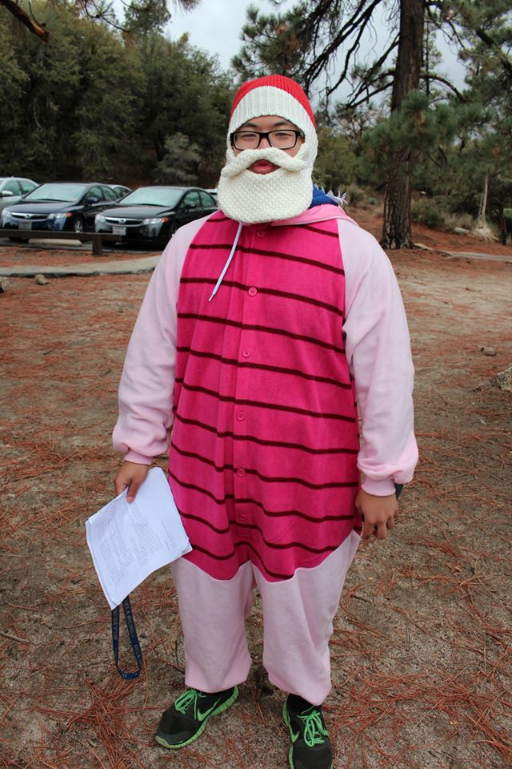
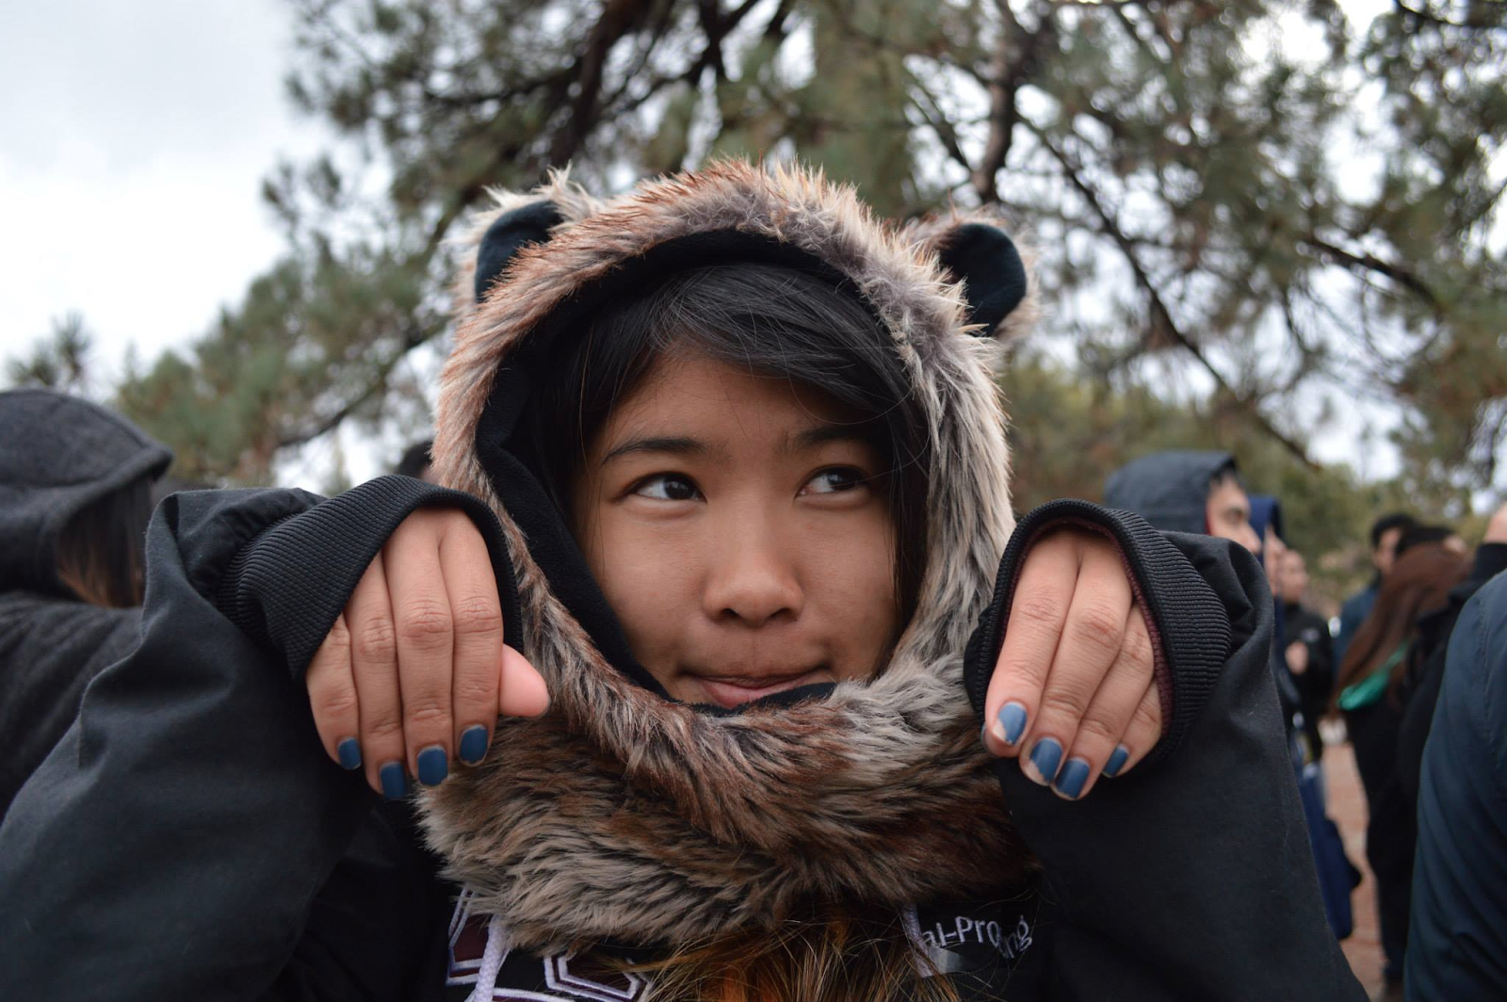
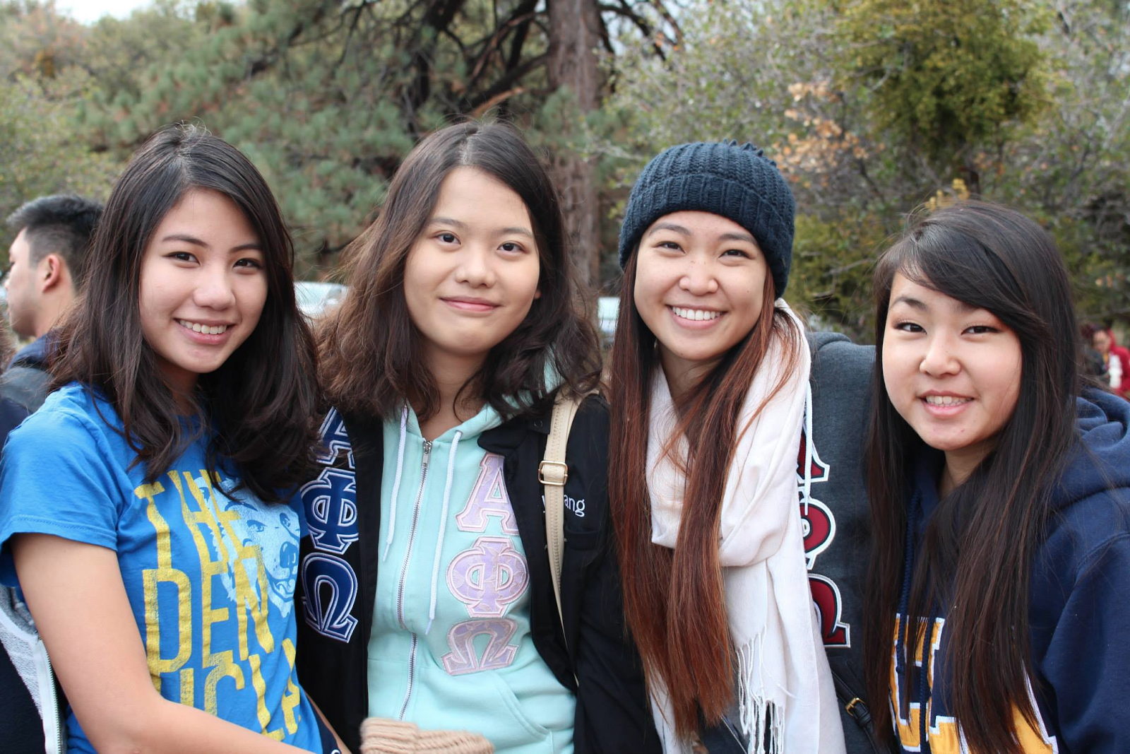
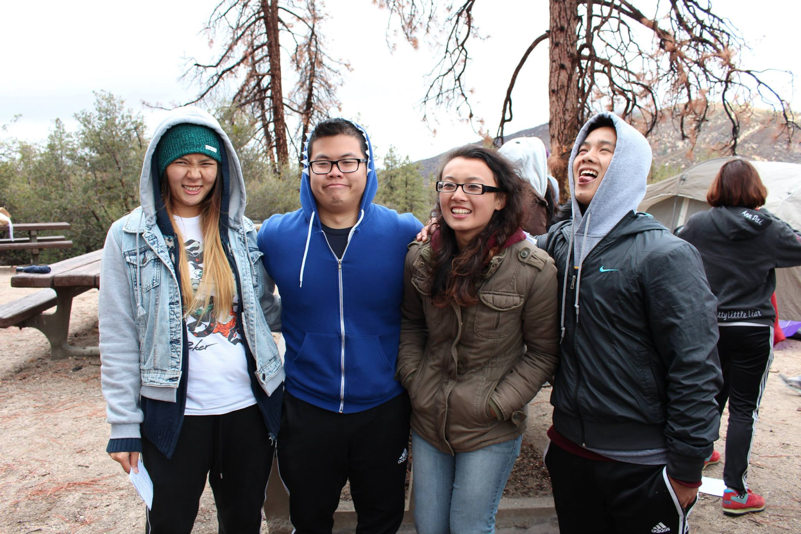
Thank you for coming to campout

Slide 22
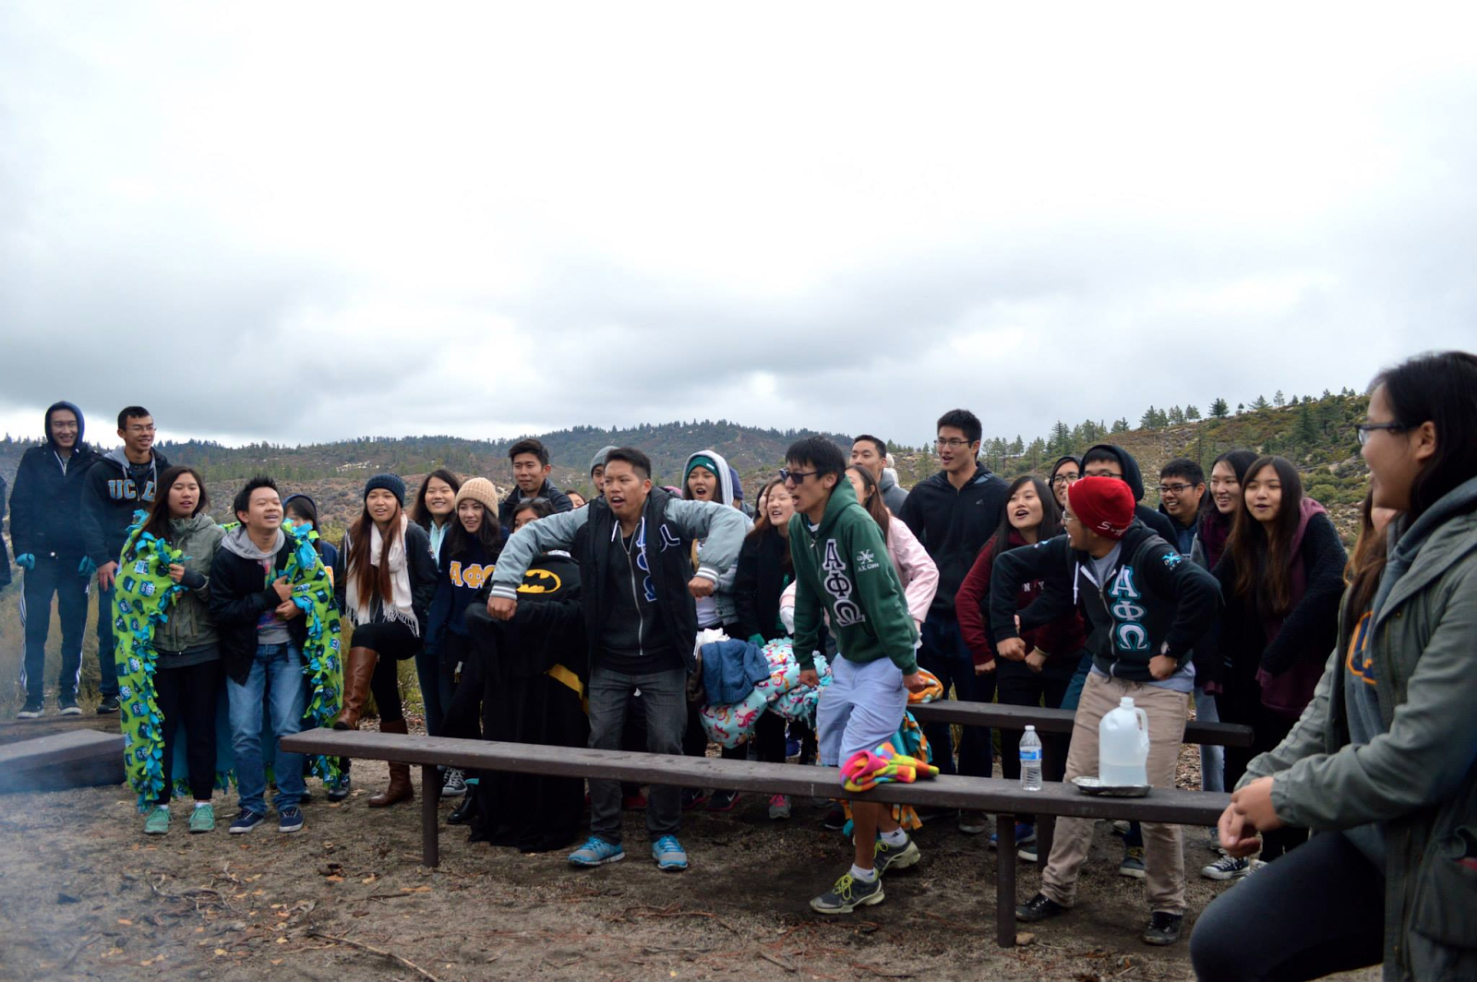
HARRISON -

Slide 23
Ski Trip
Sign up on the calendar
Pay me! Cash/Venmo
Good standing drivers > Good standing/Pledges > Associates > Bad Standing

Slide 24
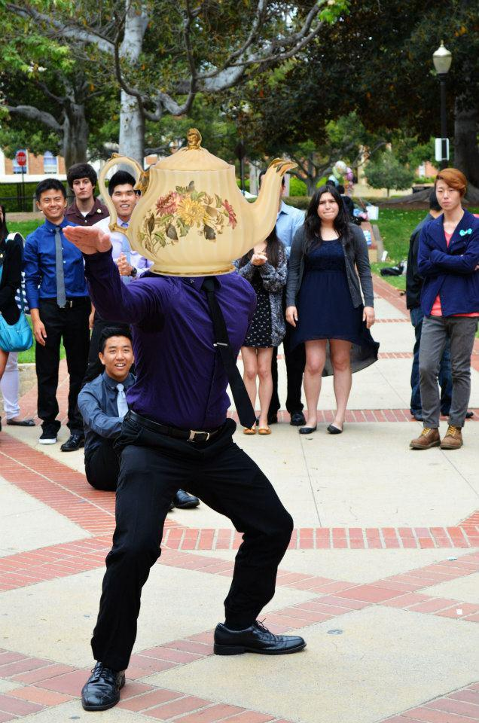

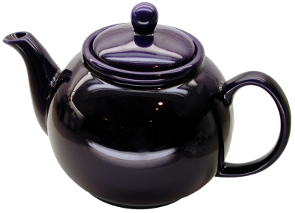


REVELATIONS

Slide 25

Revelations
THIS SUNDAY!
Invite all of your lines
and get ready to welcome
the pledges into their families~
More info will be sent via e-mail. :)
See ya thereeee!

Slide 26
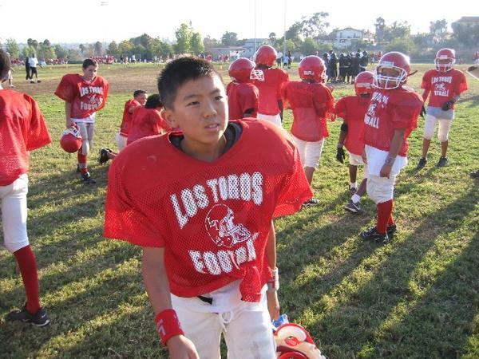
Raymond’s backstory

Slide 27

Murica.

Slide 28
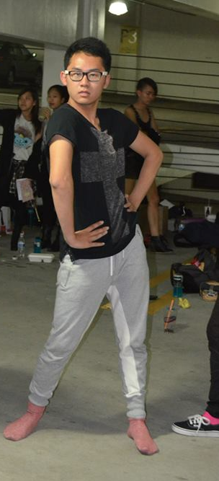
PJs & Fam shirts!
Next meeting is going to be a
VIDEO MEETING~~
WOOO
Wear PJs or Fam shirts!

Slide 29
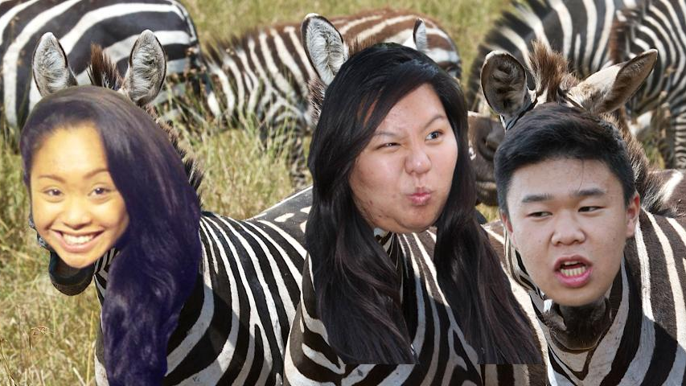
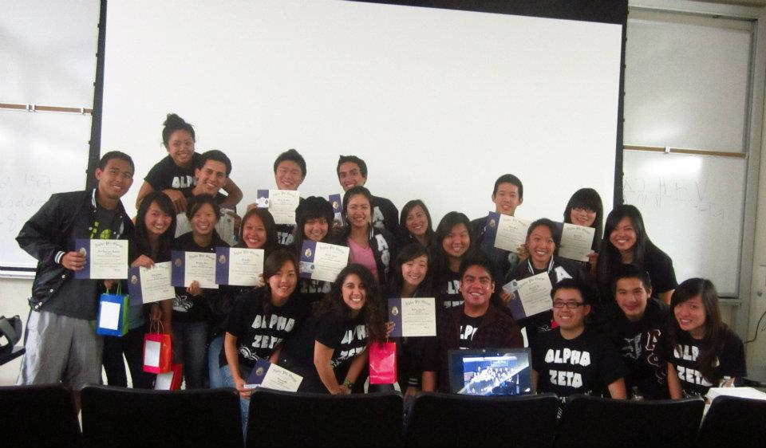
THROWBACKS~
Next week,
AZ - BRUH
Alpha Zeta
Class!

Slide 30
Service VP
Rui Guo
apoxservice@gmail.com

Slide 31

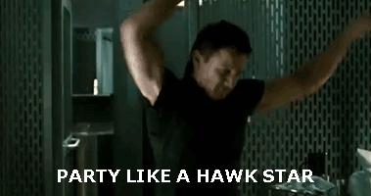
Tracker
TRACKING UPDATED AS OF 11/5
Please let me know if there were any mistakes!

Slide 32
Day of Service
Which site would you like to volunteer at?
Environmental
Family Services
Hunger and Homelessness
Pet Advocacy
Education

Slide 33

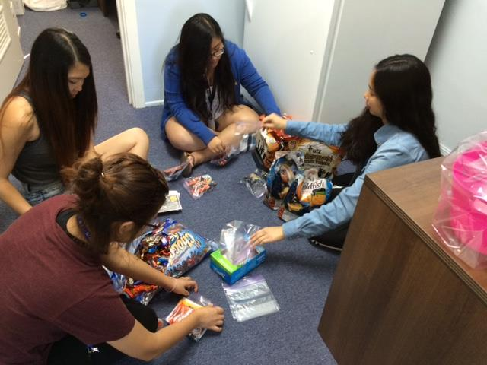
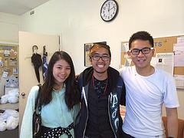
Service Highlight
MEALS ON WHEELS *VROOM VROOM*

Slide 34

Pledge Parents
Brian Lee & Emily Neai-Proeung
apoxpparents@gmail.com

Slide 35
Toast Song 4 part Harmony!
Let’s try this one more time :)!

Slide 36
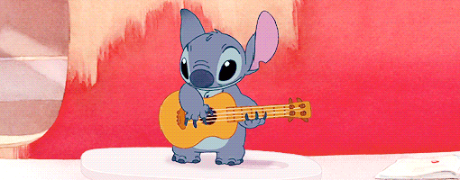
Quiz/Missions
Interviews: 10 actives
Quiz: Greek Alphabet & ParliPro
Mission: Music Videos next week!

Slide 37

Revised Interview List
It is finalized!
Let us know ASAP if you can no longer be on the list!

Slide 38

CAmpout!
Big Thank you for all the
actives who attended this term!
Thanks for trying to rough it out with us!
WE HAVE YOUR THINGS. PLS TAKE IT.

Slide 39

Revelations!
When: Sunday, 3pm - 5pm
Where: tbd by Membership
PLS INVITE UR LINE!
Get excited to meet your Little :)!

Slide 40
On a Serious note.
Don’t sign signature sheets.
Don’t gossip.

Slide 41
Finance VPs
San Li & Jonathan Liu
finance@apo-x.org

Slide 42
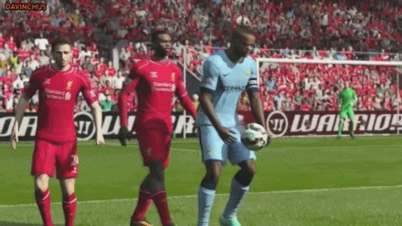
Pledges pay me dues pls!

Slide 43
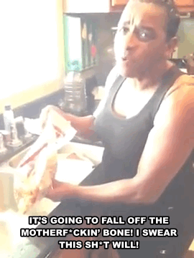
Sign up for Fundraising!!!
11/11 - TV Taping - The Odd Couple
11/14 - Fruit Cup Sale!**
11/16 - Dinner for 8
11/18 - Cake Pop Sale!**
11/21 - Settlers of Catan
11/25 - TV Taping - The Millers
**Sign up for the service event for fruit cups/cake pops**

Slide 44
Fellowship VPs
Ann Dai & Danny Ly
fellowship@apo-x.org

Slide 45
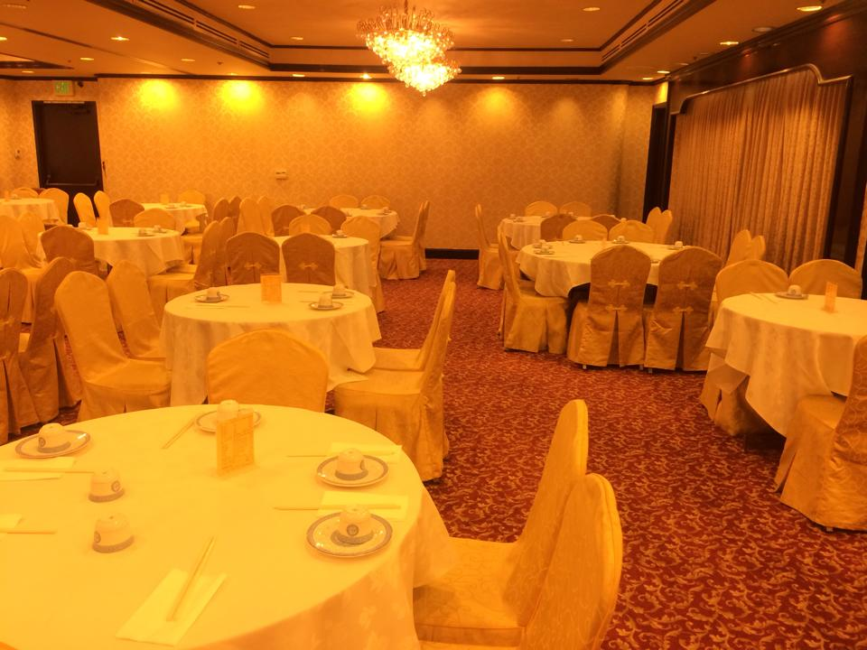
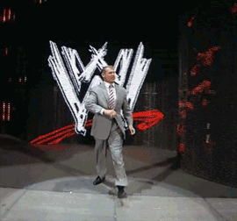
Looking good night
Dinner family style
Musical and dance performances!
Games/activities
Photo booth

Slide 46
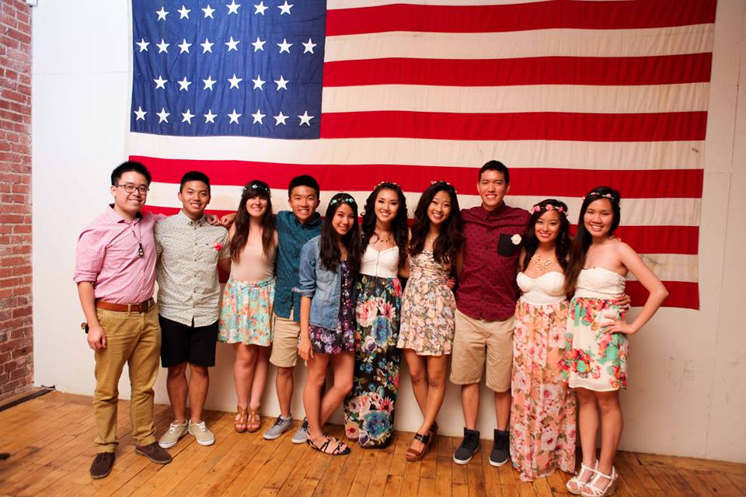
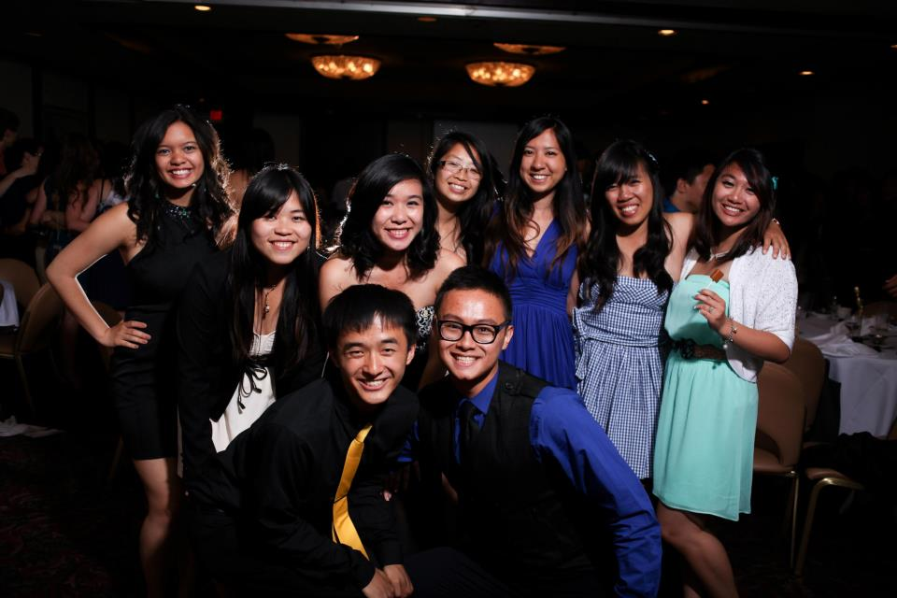
Looking good night

Slide 47
Looking good night
https://www.youtube.com/watch?v=_tHdL5z9U_s&list=UU1ytern-1MmJho0rHWuMlmA#t=255

Slide 48
Looking good night
Sign up on the calendar and pay by 11/12 for $22!
Late payments are $24
Please pay Melissa Ma, Lucy Diep, John Young, Joanne Kung, Peter Vo, or Nicole Nguyen
Sign up for performances with Melissa Ma!!

Slide 49
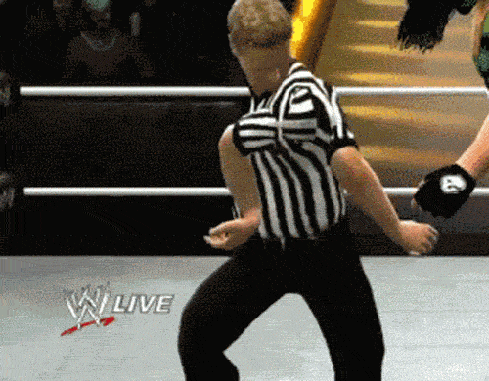
IM SPORTS
IM Volleyball Tonight
SAC 2nd Floor at 10pm
IM Indoor Soccer starts tmr 11/6!
Wooden Court #1 at 7:45pm

Slide 50

Questions/IDeas?
Let us know if you have any questions or ideas for Fellowships! Thank you!!

Slide 51

Historian
Juana Li
historian@apo-x.org

Slide 52
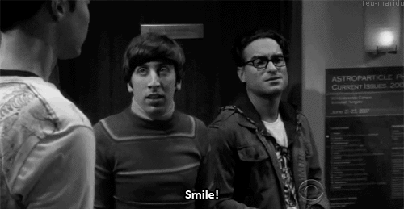
Updates
Come see me after meeting to take your headshots for the term book! =D

Slide 53
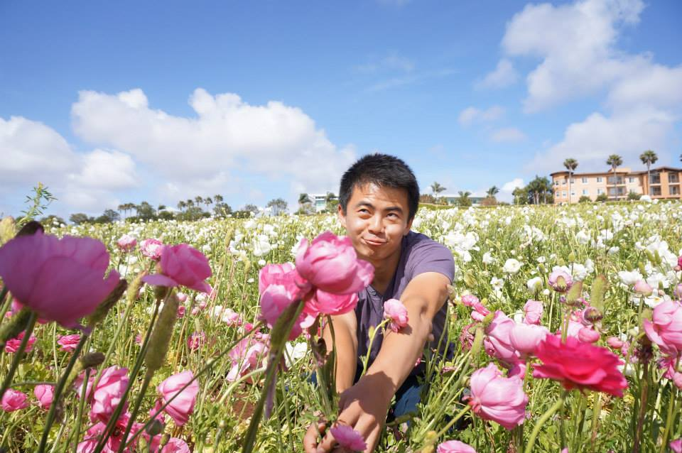
Brothers of Chi Chapter
Winner: JT - “I am APO’s little Rui of sunshine”
Runner-up: Joseph Chan - “Let’s get one thing straight… I’m not.”

Slide 54
BOTW
This weeks Brother of the week is a group of people that went out of their way to help out someone that was in danger. On their way down from campout, they noticed that someone needed help and found out that a person ran off the cliff in their car. Our Brothers pulled over and formed a human link to help get the person back to safety.
THANK YOU FOR YOUR SERVICE TO THE COMMUNITY! <3

Slide 55
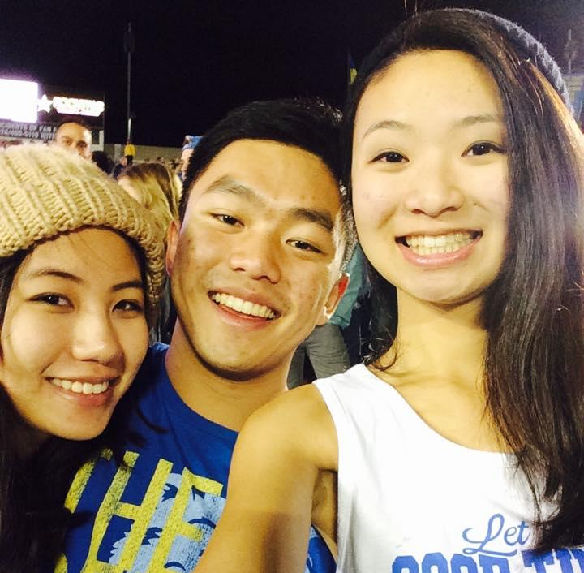
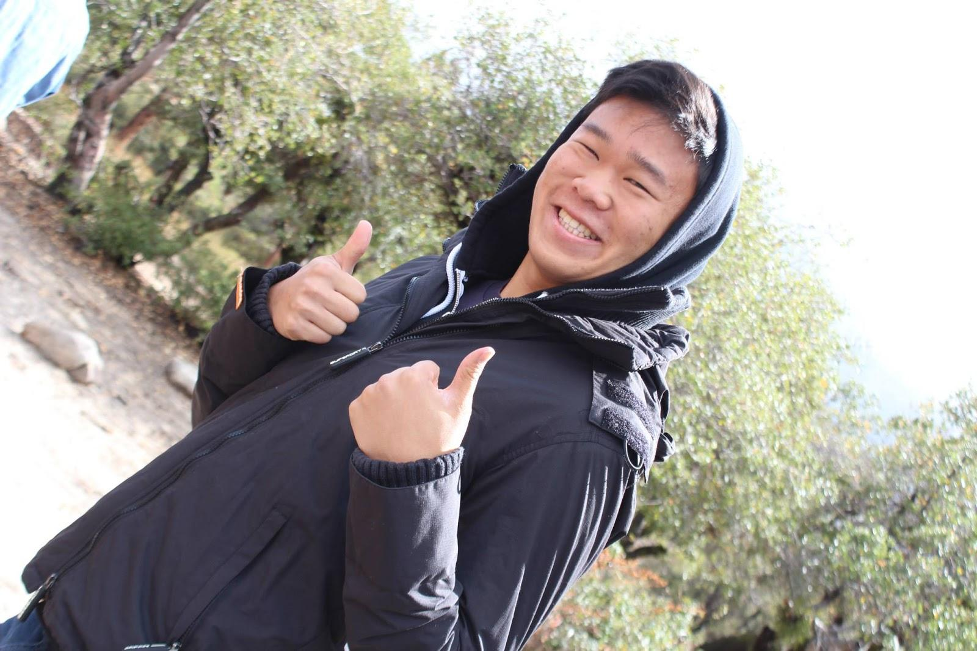
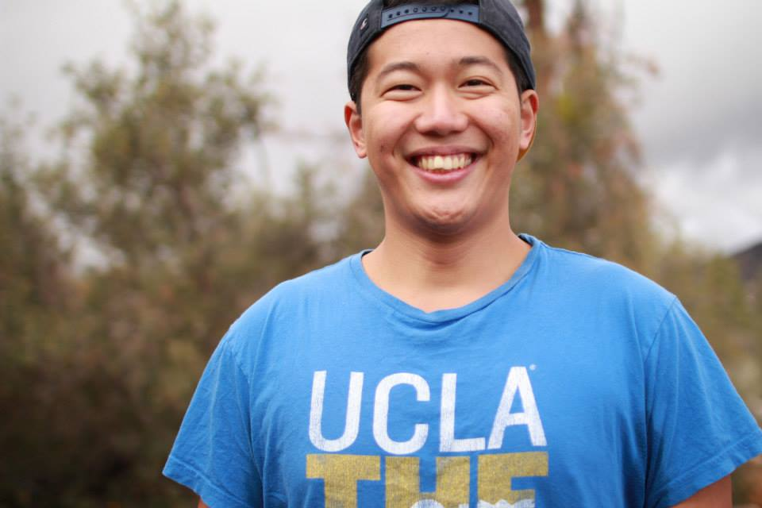
Michael, Fay, Victor, Irene, Alex

Slide 56
Webisode #2
Thank you Vickie for making this weeks webisode!
http://vimeo.com/110948447

Slide 57
Sergeant-at-Arms
apoxsergeant@gmail.com

Slide 58
Acting SAA:
Katherine Cardoza!

Slide 59
Interchapter Chair
Chanel Ng
interchapter@apo-x.org

Slide 60
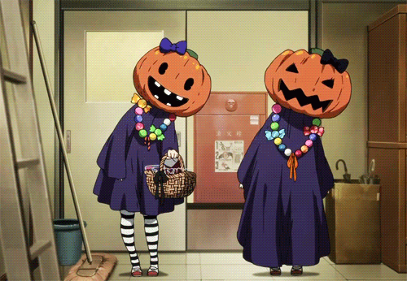
Universal Studios Horror Night
“Clowns 3D was the absolute scariest thing I have ever experienced. The 3D glasses made everything all trippy and the neon green and orange kinda made me want to throw up. Crazy clown people were jumpin out of windows and scaring everyone. Josh, Sherry, and me were linked together arm in arm, cowering in fear while Chanel was attached to an IC pledge from Alpha Kappa. I spotted a slightly open door and I tried to do a service to the fraternity by closing it with my foot, but then a clown jumped out of it and scared the crap out of Josh. (Sorry Josh). The rest of the maze was really scary and I don't wanna relive it by writing down the gory details.” - Bowen Lu

Slide 61


Alpha Delta’s APO Formals
“A Night in Paris”
When: November 21, 2014 | Where: SDSU
Cost: For ICs it is $FREE.99!!!

Slide 62
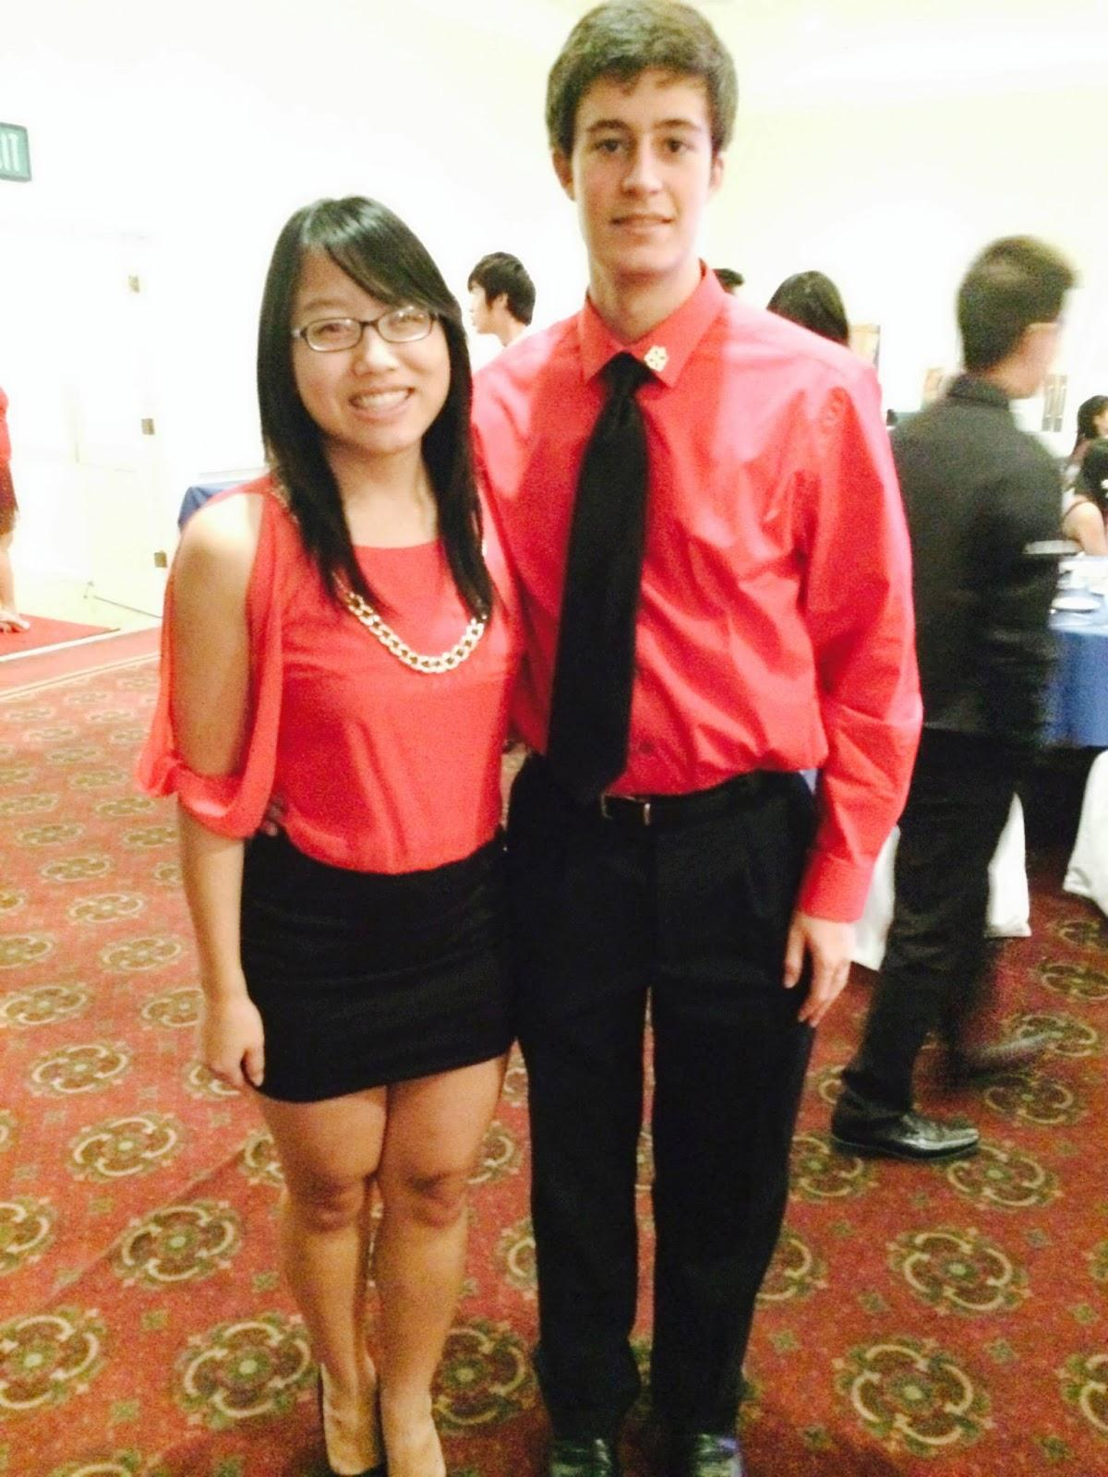
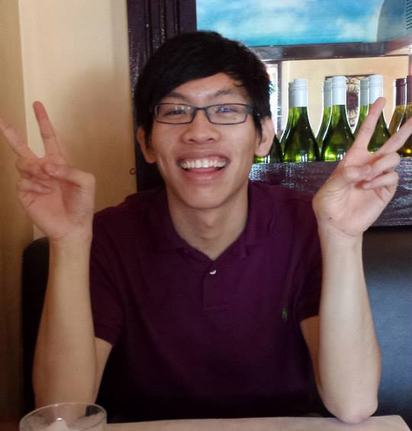
Nationals Attendees!
Bowen Lu
Winnie Banh and T-Brigs

Slide 63

Preview of IC Wristbands~

Slide 64
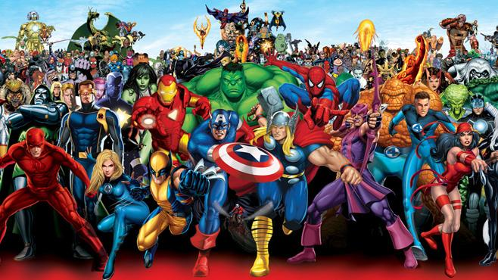
CAC
Paul Choung
cac@apo-x.org

Slide 65
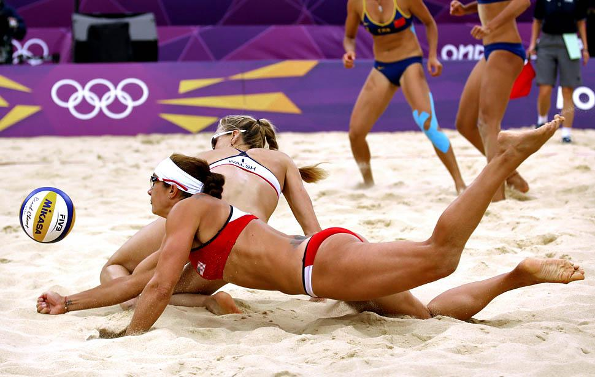
CAC
Friday, 11/07, 11:30 AM - 12:30 PM at Kerckhoff
(11:30-11:45 slot reserved for William Chin)
Saturday, 11/08, 2 PM - 5 PM, Sunset Volleyball
Friday, 11/14, 6 PM - 11 PM, Looking Good Night
Saturday, 11/15, 2 PM - 5 PM, Sunset Volleyball 2
ASSCAC
contact Assistant CAC Tristan Darvin at asscac@apo-x.org

Slide 66
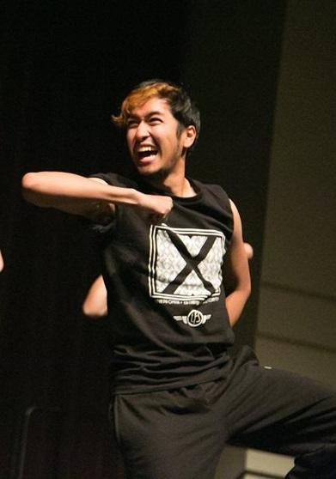
AAA AAAA?

Slide 67


Slide 68
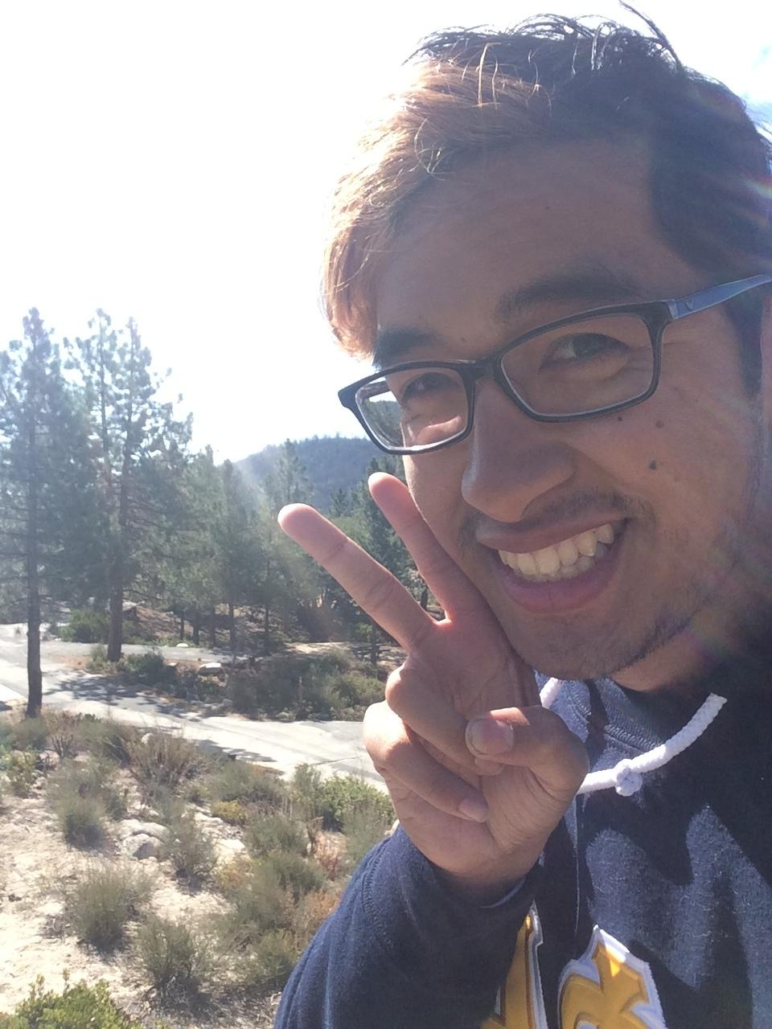
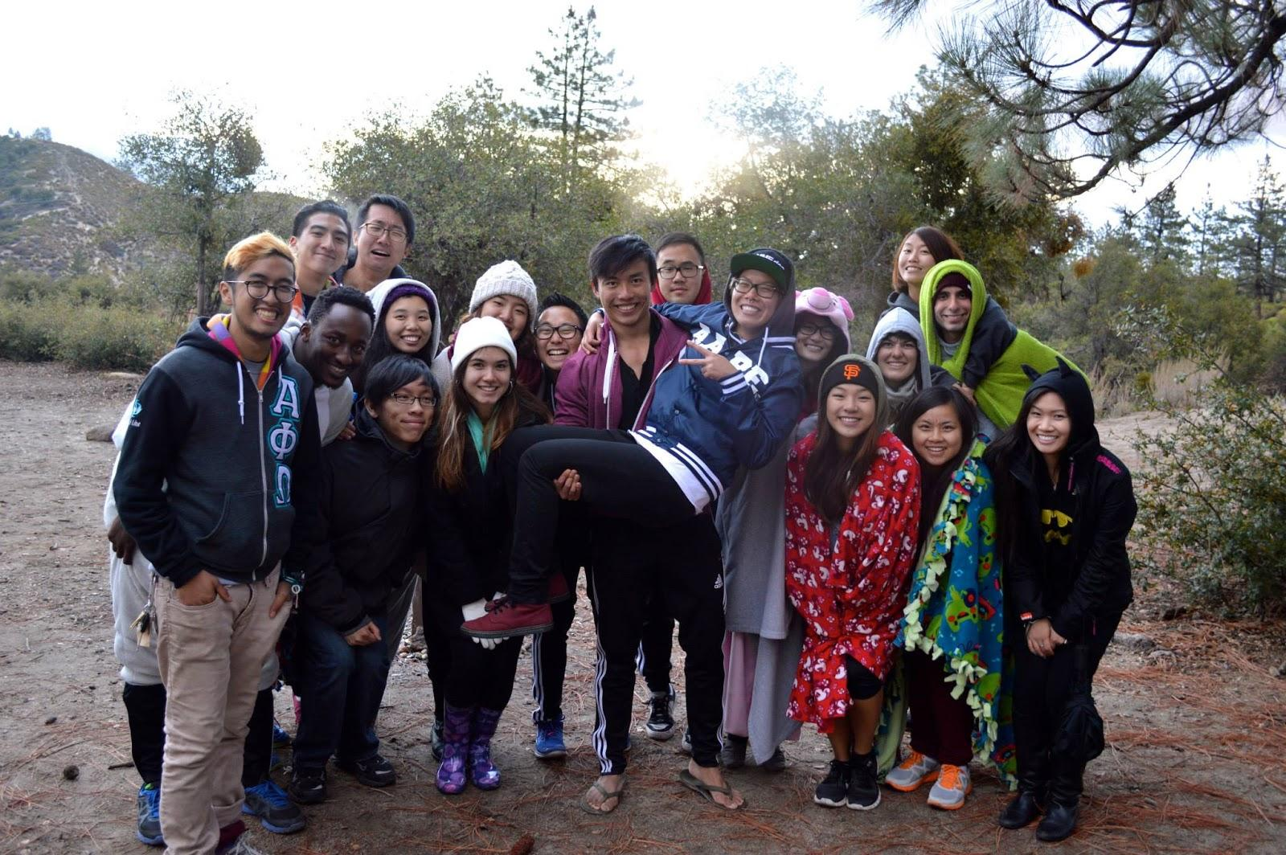
Abelard Bautista
UCLA (2009-2014)
Psychobio | Music History | Neuroscience
Alpha Kappa | David A. Emery | Fall 2014

Slide 69
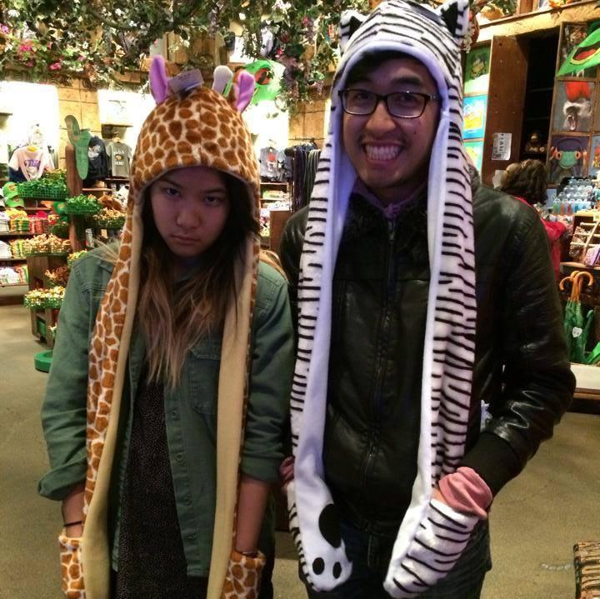
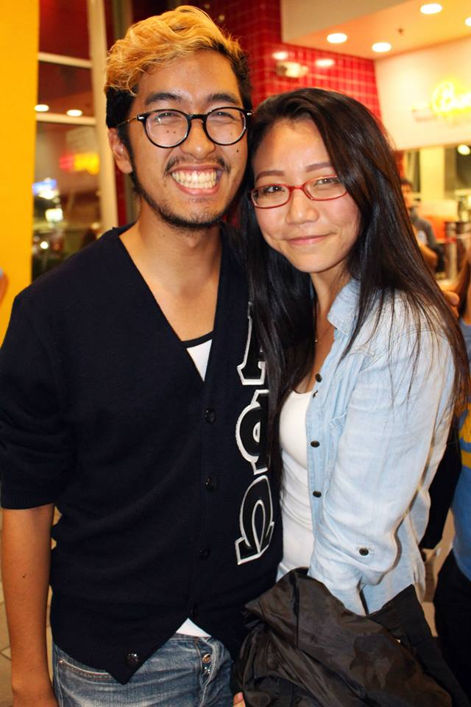
“Abelard, who are your big and little(s)?”

Slide 70
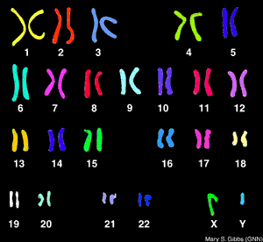


Genetic Testing Laboratory
Aneuploidy Testing for Embryos
(1) Pre-Implantation Genetic Screening (PGS)
(2) Pre-Implantation Genetic Diagnosis (PGD)
(3) GenderSure

Slide 72
Contact Information
Please feel free to come talk to me after?
Or whenever?
Or let’s go on a food adventure?
E-mail
abelardbautista@hotmail.com

Slide 73

Last Piece of Advice?

Slide 74
Advisor Special Election
Process:
3 minute presentation
5 follow up questions
Nominee leaves
5 open floor comments
Voting
Nominee
Abelard Bautista CONGRATTTSSSSS!!! :D

Slide 75
SAA Special Election Nomination
Vote will take place CM5
Nominees
Katherine Cardoza
Abram Summers
George Hsin

